Slide 1
Blacktown Chinese Christian Church
Welcome to Our English Service 04.05.2025
English Service 9:45 – 11:00 am
Worship Songs: Passage: Speaker: Topic: Response Song: Announcements and Closing Prayer Benediction
Heart Of Worship My Labour Is Not In Vain Living Hope 1 Samuel 8 TBA TBA TBA

Slide 2
BCCC english service

Slide 3

Please keep all phones on silent

Slide 4
The Heart Of Worship
Tim Hughes © 2000 Thankyou Music (Admin. by SHOUT! Music Publishing Australia) CCLI Licence No. 5485849. CCLI Song number: 3266032

Slide 5
Verse 1
When the music fades
All is stripped away
And I simply come

Slide 6
Verse 1
Longing just to bring
Something that's of worth
That will bless Your heart

Slide 7
Pre-Chorus
I'll bring You more than a song
For a song in itself
Is not what You have required

Slide 8
Pre-Chorus
You search much deeper within
Through the way things appear
You're looking into my heart

Slide 9
Chorus
I'm coming back to the heart of worship
And it's all about You, it's all about You, Jesus
I'm sorry, Lord, for the thing I've made it
When it's all about You, it's all about You, Jesus

Slide 10
Verse 2
King of endless worth
No one could express
How much you deserve

Slide 11
Verse 2
Though I'm weak and poor
All I have is Yours
Every single breath

Slide 12
Pre-Chorus
I'll bring You more than a song
For a song in itself
Is not what You have required

Slide 13
Pre-Chorus
You search much deeper within
Through the way things appear
You're looking into my heart

Slide 14
Chorus 1
I'm coming back to the heart of worship
And it's all about You, it's all about You, Jesus
I'm sorry, Lord, for the thing I've made it
When it's all about You, it's all about You, Jesus

Slide 15
Chorus 2
I'm coming back to the heart of worship
And it's all about You, it's all about You, Jesus
I'm sorry, Lord, for the thing I've made it
When it's all about You, it's all about You, Jesus

Slide 16
Outro
I'll bring you more than a song
I'll bring you more than a song
More than a song

Slide 17
Outro
I'll bring you more than a song
I'll bring you more than a song
More than a song

Slide 18
Outro
You're looking into my heart,
looking into my heart
You're looking into my heart

Slide 19
Outro
You're looking into my heart,
looking into my heart
You're looking into my heart

Slide 20
My Labour Is Not In Vain
CCLI Licence No: 5485849

Slide 21
Verse 1
My work in Christ is not in vain
My labor will not fail
For when I toil in Jesus’ name
His purpose will prevail

Slide 22
Verse 2
The tasks that You have set for me
I may not understand
Yet I will follow where You lead
I trust Your sovereign hand

Slide 23
Chorus
So may all I do, be it great or small
Bring glory to Your name

Slide 24
Chorus
In Your grace alone I will car – ry on
Your promise to me remains
My labour is not in vain

Slide 25
Verse 3
Go forth, You said, take up your cross
And set the captive free
So give me feet to seek the lost
Just as You searched for me

Slide 26
Chorus
So may all I do, be it great or small
Bring glory to Your name

Slide 27
Chorus
In Your grace alone I will car – ry on
Your promise to me remains
My labour is not in vain

Slide 28
Verse 4
Take heart, my soul, and persevere
Just as your Saviour did
For soon you will be home at rest
Your work, complete in Him

Slide 29
Chrous
So may all I do, be it great or small
Bring glory to Your name

Slide 30
Chrous
In Your grace alone I will car – ry on
Your promise to me remains
My labour is not in vain

Slide 31
Chrous
So may all I do, be it great or small
Bring glory to Your name

Slide 32
Chrous
In Your grace alone I will car – ry on
Your promise to me remains
My labour is not in vain

Slide 33
Living Hope
Brian Johnson, Phil Wickham © 2017 Phil Wickham Music (Admin. by Crossroad Distributors Pty. Ltd.) Simply Global Songs (Admin. by Crossroad Distributors Pty. Ltd.) Sing My Songs (Admin. by Crossroad Distributors Pty. Ltd.) Bethel Music Publishing (Admin. by SHOUT! Music Publishing Australia) CCLI Licence No. 5485849. CCLI Song number: 7106807

Slide 34
Verse 1
How great the chasm that lay between us
How high the mountain I could not climb
In desperation, I turned to heaven
And spoke Your name into the night

Slide 35
Verse 1
Then through the darkness, Your loving kindness
Tore through the shadows of my soul
The work is ﬁnished, the end is written
Jesus Christ, my living hope

Slide 36
Verse 2
Who could imagine so great a mercy?
What heart could fathom such boundless grace?
The God of ages stepped down from glory
To wear my sin and bear my shame

Slide 37
Verse 2
The cross has spoken, I am forgiven
The King of Kings calls me His own
Beautiful Savior, I'm Yours forever
Jesus Christ, my living hope

Slide 38
Chorus
Hallelujah, praise the One who set me free
Hallelujah, death has lost its grip on me

Slide 39
Chorus
You have broken every chain
There's salvation in Your name
Jesus Christ, my living hope

Slide 40
Chorus
Hallelujah, praise the One who set me free
Hallelujah, death has lost its grip on me

Slide 41
Chorus
You have broken every chain
There's salvation in Your name
Jesus Christ, my living hope

Slide 42
Verse 3
Then came the morning that sealed the promise
Your buried body began to breathe
Out of the silence, the Roaring Lion
Declared the grave has no claim on me (x2)

Slide 43
Verse 3
Jesus, Yours is the victory

Slide 44
Chorus
Hallelujah, praise the One who set me free
Hallelujah, death has lost its grip on me

Slide 45
Chorus
You have broken every chain
There's salvation in Your name
Jesus Christ, my living hope

Slide 46
Outro
Hallelujah, praise the One who set me free
Hallelujah, death has lost its grip on me

Slide 47
Outro
You have broken every chain
There's salvation in Your name
Jesus Christ, my living hope

Slide 48
Tag
Jesus Christ, my living hope
Oh God, You are my living hope

Slide 49
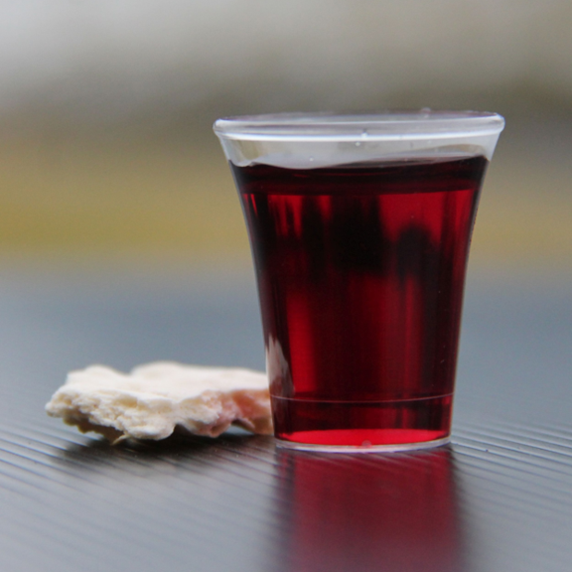
Holy Communion

Slide 50

Bible reading

Slide 51
1 Samuel 8 (NIV)
When Samuel grew old, he appointed his sons as Israel’s leaders. ² The name of his firstborn was Joel and the name of his second was Abijah, and they served at Beersheba.

Slide 52
1 Samuel 8 (NIV)
³ But his sons did not follow his ways. They turned aside after dishonest gain and accepted bribes and perverted justice.
⁴ So all the elders of Israel gathered together and came to Samuel at Ramah.

Slide 53
1 Samuel 8 (NIV)
⁵ They said to him, “You are old, and your sons do not follow your ways; now appoint a king to lead us, such as all the other nations have.”
⁶ But when they said, “Give us a king to lead us,” this displeased Samuel; so he prayed to the Lord.

Slide 54
1 Samuel 8 (NIV)
⁷ And the Lord told him: “Listen to all that the people are saying to you; it is not you they have rejected, but they have rejected me as their king. ⁸ As they have done from the day I brought them up out of Egypt until this day, forsaking me and serving other gods, so they are doing to you.

Slide 55
1 Samuel 8 (NIV)
⁹ Now listen to them; but warn them solemnly and let them know what the king who will reign over them will claim as his rights.”
¹⁰ Samuel told all the words of the Lord to the people who were asking him for a king.

Slide 56
1 Samuel 8 (NIV)
¹¹ He said, “This is what the king who will reign over you will claim as his rights: He will take your sons and make them serve with his chariots and horses, and they will run in front of his chariots. ¹² Some he will assign to be commanders of thousands and commanders of fifties, and others to plow his ground and reap his harvest, and still others to make weapons of war and equipment for his chariots.

Slide 57
1 Samuel 8 (NIV)
¹³ He will take your daughters to be perfumers and cooks and bakers. ¹⁴ He will take the best of your fields and vineyards and olive groves and give them to his attendants.

Slide 58
1 Samuel 8 (NIV)
¹⁵ He will take a tenth of your grain and of your vintage and give it to his officials and attendants. ¹⁶ Your male and female servants and the best of your cattle and donkeys he will take for his own use.

Slide 59
1 Samuel 8 (NIV)
¹⁷ He will take a tenth of your flocks, and you yourselves will become his slaves. ¹⁸ When that day comes, you will cry out for relief from the king you have chosen, but the Lord will not answer you in that day.”

Slide 60
1 Samuel 8 (NIV)
¹⁹ But the people refused to listen to Samuel. “No!” they said. “We want a king over us. ²⁰ Then we will be like all the other nations, with a king to lead us and to go out before us and fight our battles.”

Slide 61
1 Samuel 8 (NIV)
²¹ When Samuel heard all that the people said, he repeated it before the Lord. ²² The Lord answered, “Listen to them and give them a king.”
Then Samuel said to the Israelites, “Everyone go back to your own town.”

Slide 62
Scripture quotations taken from The Holy Bible, New International Version® NIV®
Copyright © 1973, 1978, 1984, 2011 by Biblica, Inc.
Used with permission. All rights reserved worldwide.

Slide 63
Announcements

Slide 64





Account name: Blacktown Chinese Christian Church
Account number: 4216 50263
Offering
BSB: 112 - 879
Please put in "offering" as the reference
The offering box is available at the back of the hall

Slide 65
Prayer points

Slide 66
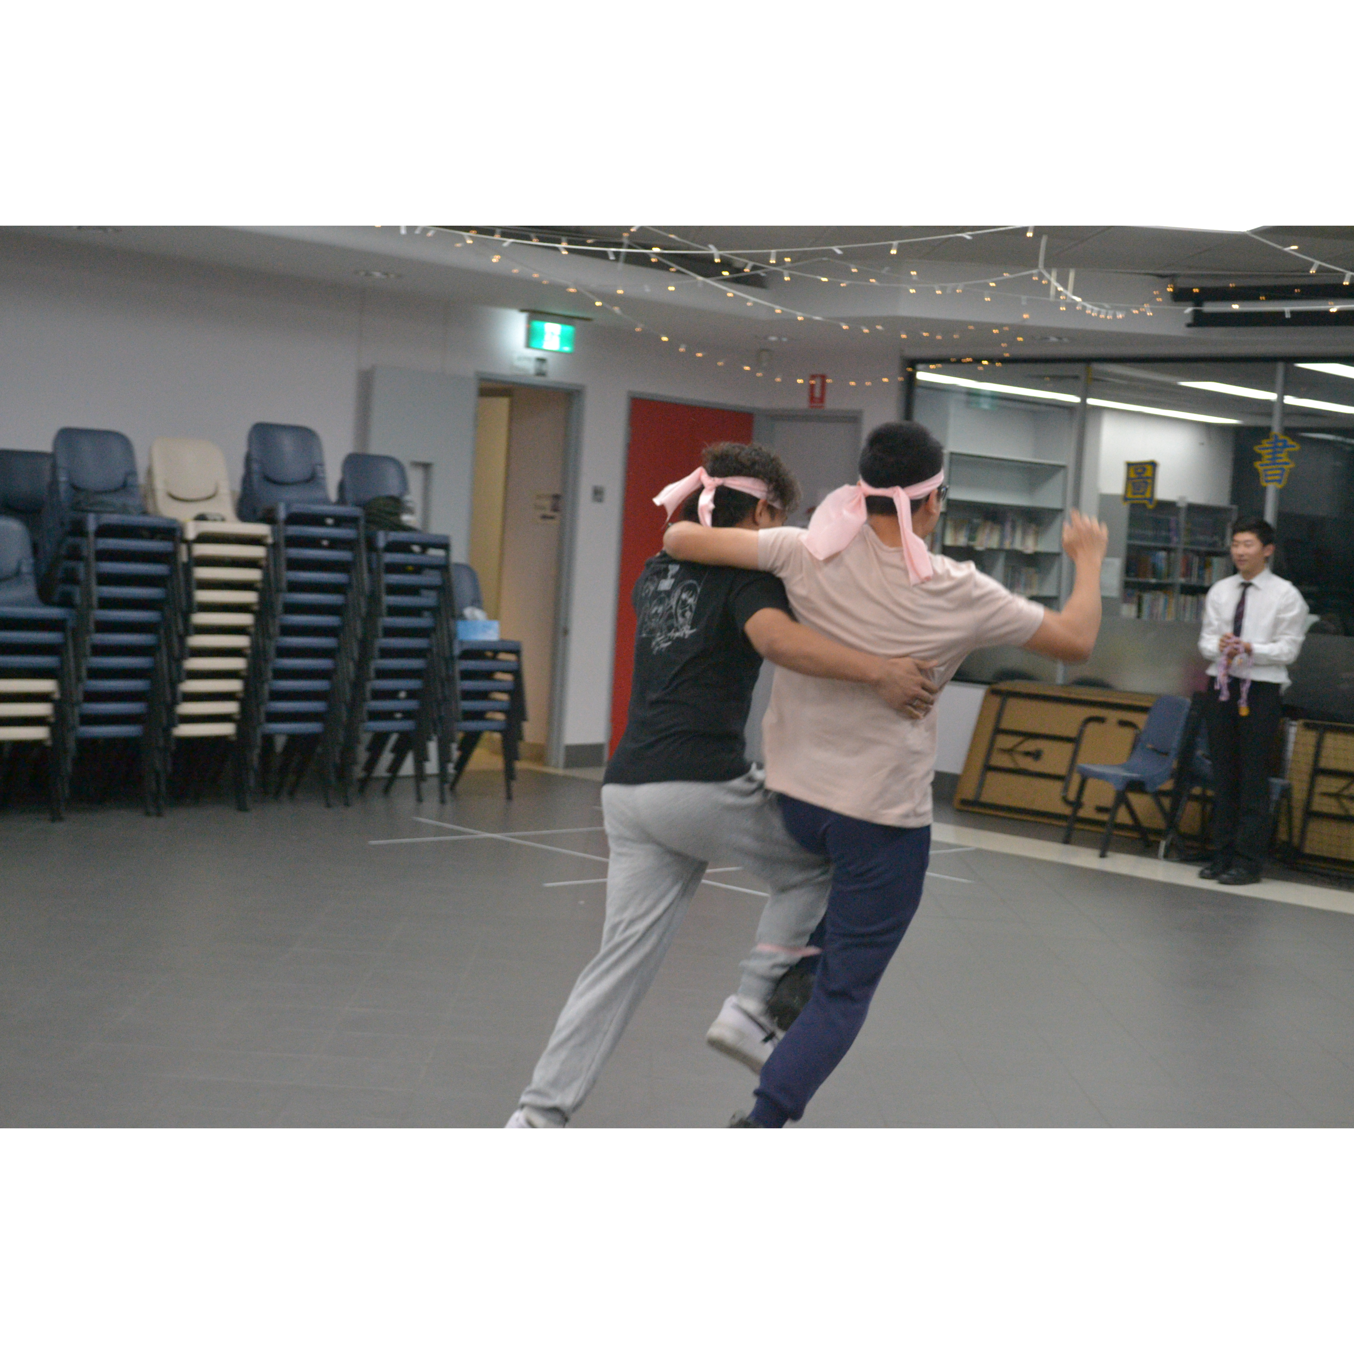
Mingle time!

